Slide 1
1. 1 Statistical Methods in the Context of Scientific Studies

Slide 2
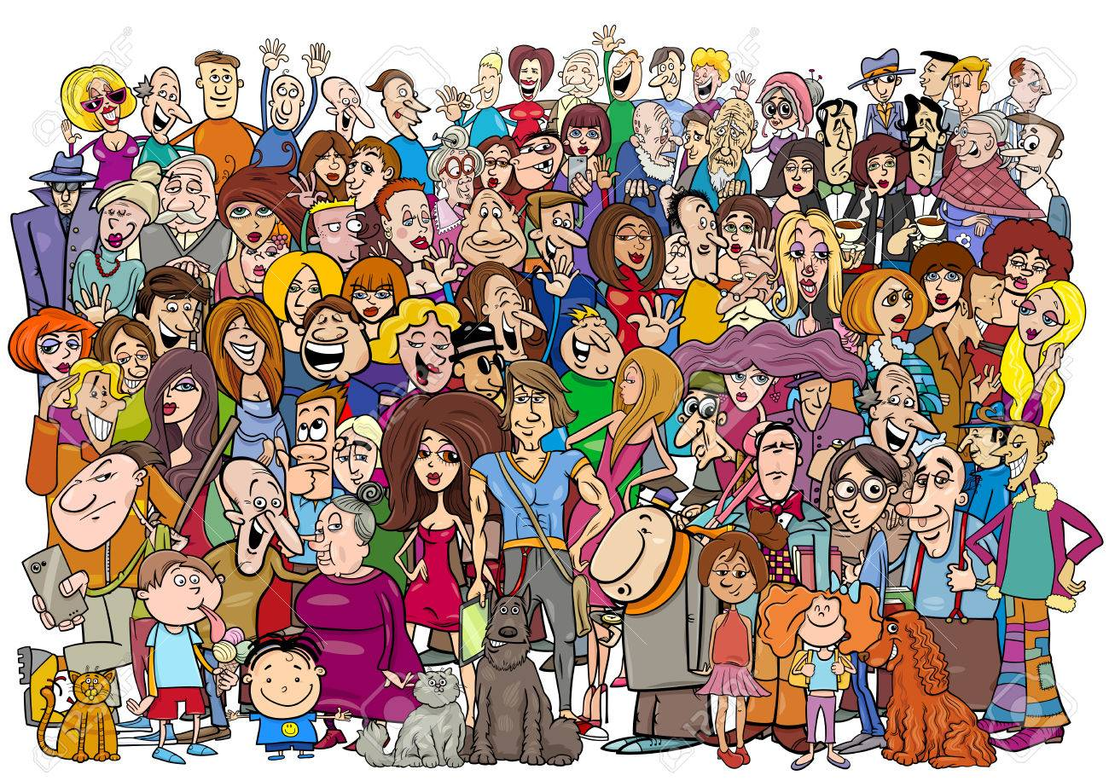
The overall objective of statistical methods is to use empirical evidence in order to improve our knowledge about the target population.

Slide 3

What name is given to a set of characteristics (e.g. age, size, weight) that are related to our study and that can change or vary from one member of the population to another?
variables

Slide 4
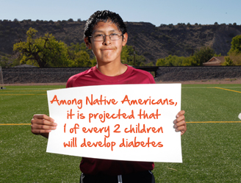
We refer to variables that are the main focus of our study as the response (or target) variable.

Slide 5
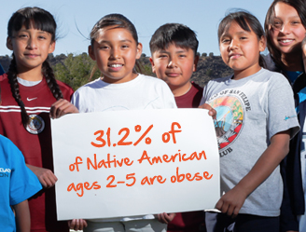
Variables that explain or predict variation in the variation in the response variables as explanatory variables.

Slide 6
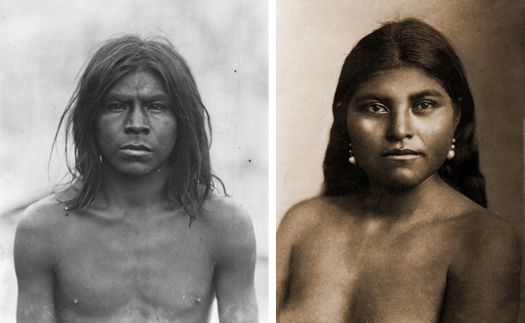
Pima Indian Data Set

Slide 7

The Feb 2, 1998 edition of
The New Yorker magazine

Slide 8

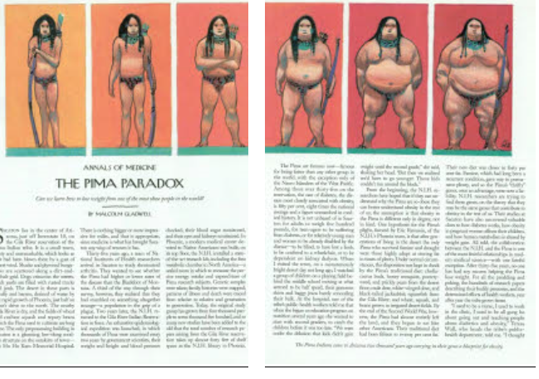
(New Yorker magazine, Annals of Medicine, February 2, 1998)

Slide 9
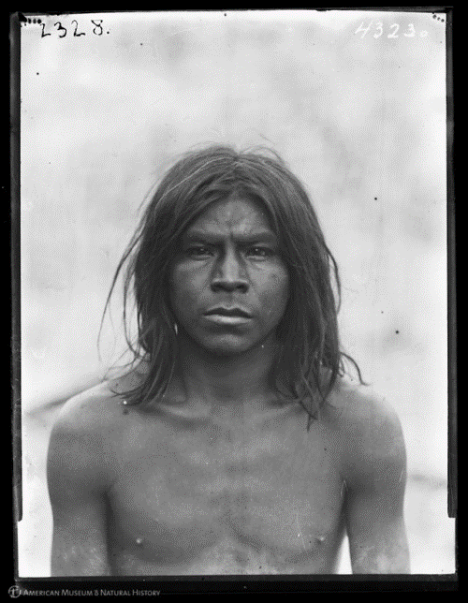
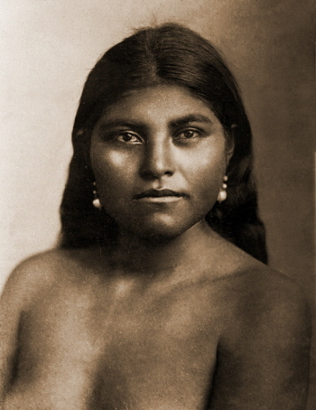
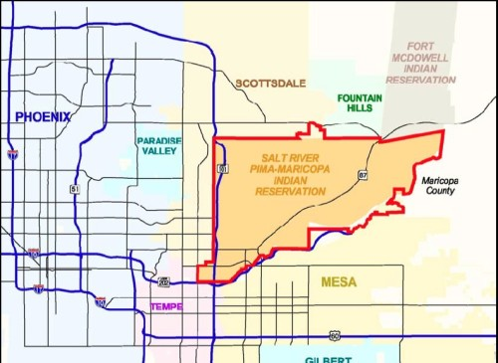
Exploratory Data Analysis (EDA)
We will use the Pima Indian data set for finding the mean and median.
Prima Indians (100 years ago)

Slide 10
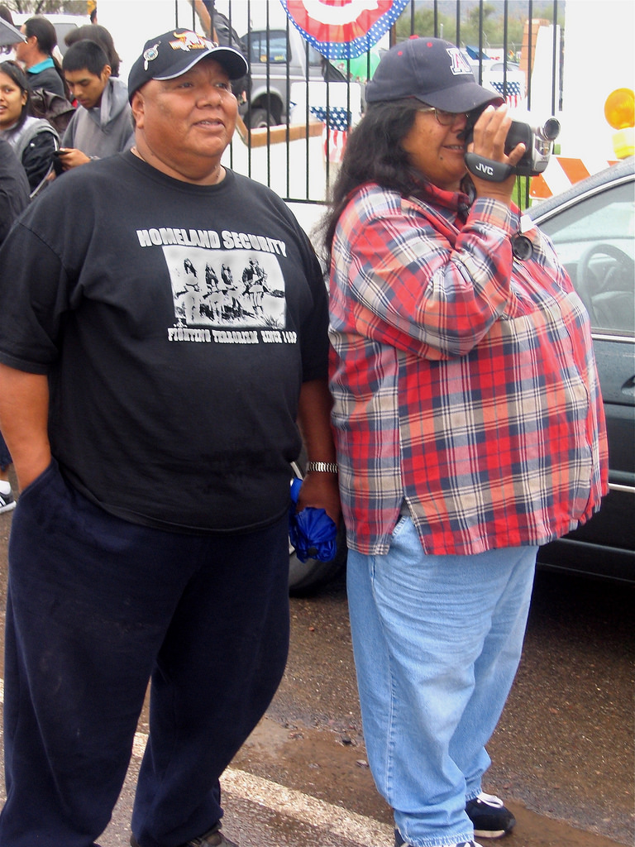
Exploratory Data Analysis (EDA)
The Pima Indians have changed a lot in the last 100 years!
Prima Indians (today)

Slide 11
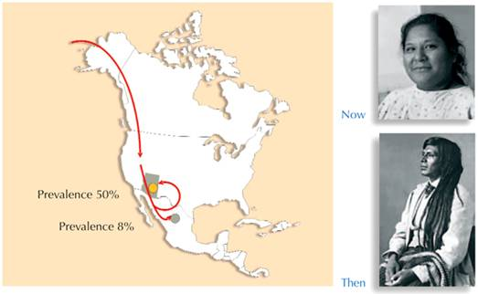
Genetics and Lifestyle Cause Type 2 Diabetes
Pima Indians living in Mexico have a diabetes prevalence of about 8%, whereas those who
have emigrated to the USA, where the lifestyle is more sedentary and access to energy dense (fatty) food is easier, have a diabetes prevalence of about 50% respectively.

Slide 12
Question: Is Type 2 Diabetes Mellitus caused by a person’s environment (i.e from obesity caused by overnutrition) or by their genetic makeup?

Slide 13
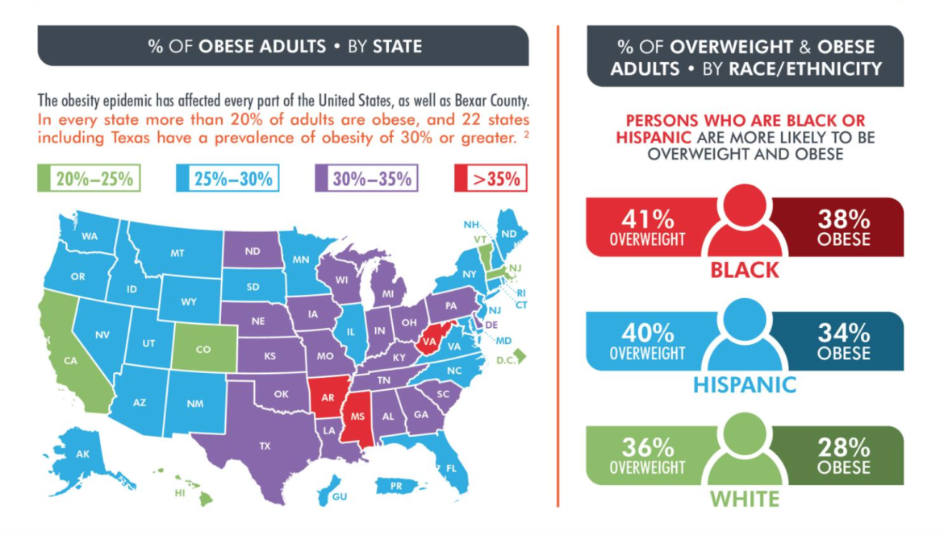
You are here

Slide 14
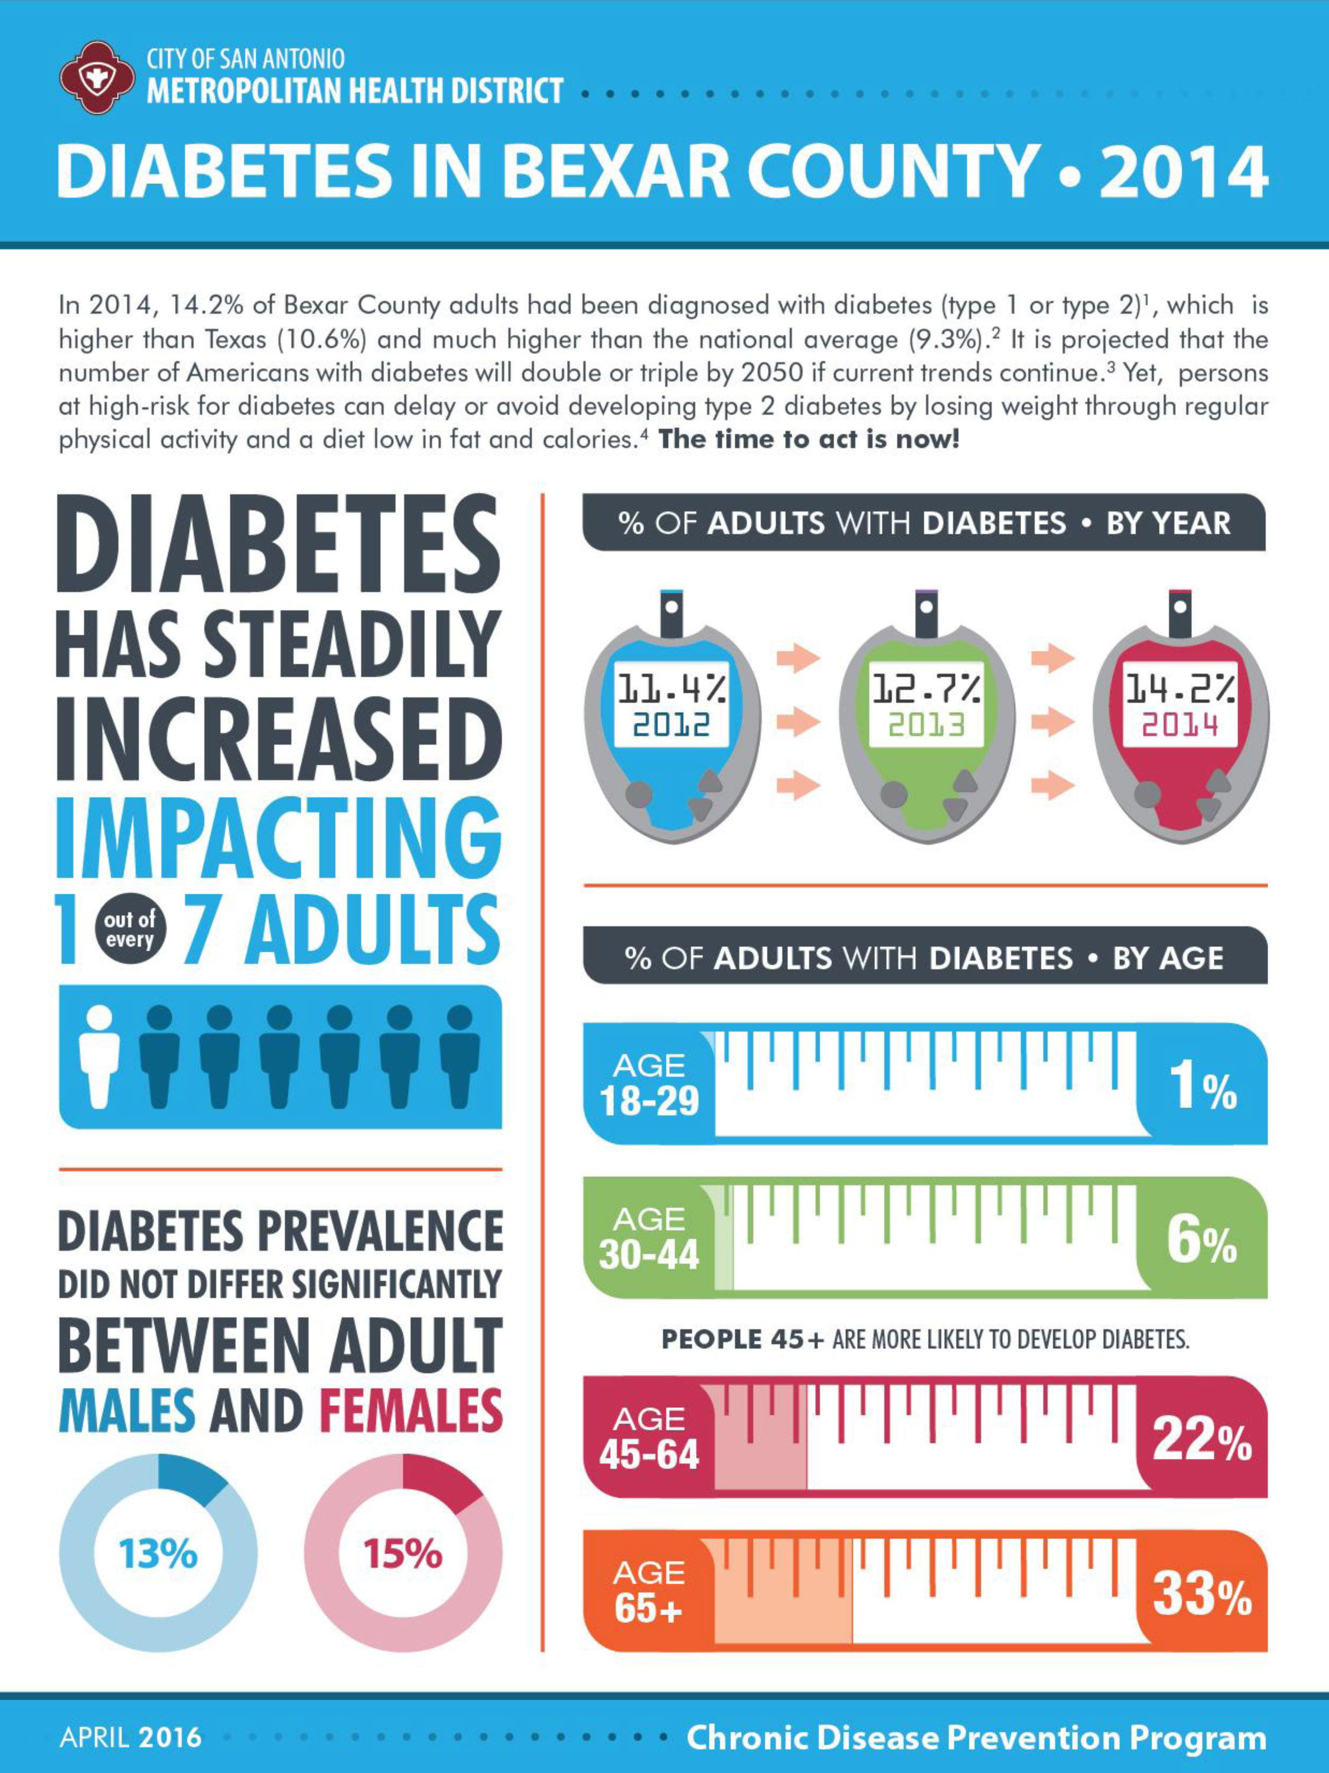
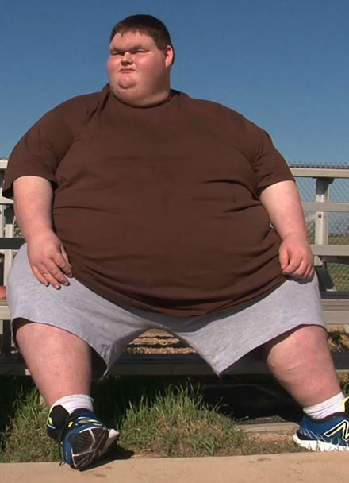
Type 2 Diabetes is growing rapidly in San Antonio

Slide 15
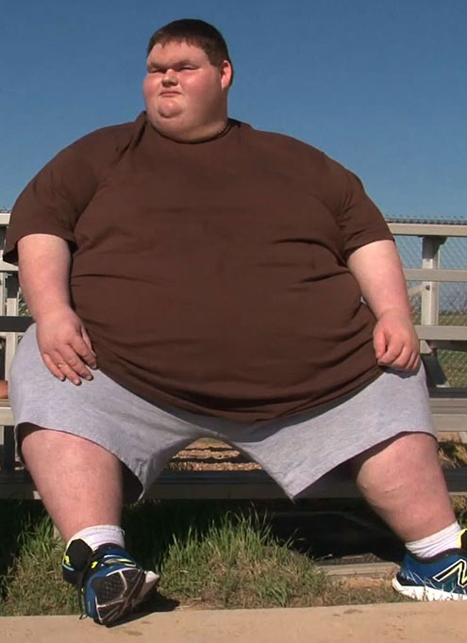
Type 2 Diabetes and Obesity
The Pima are now famous for being fatter than any other group in the world. Among those over 35, the rate of diabetes is 50%, a figure unmatched by in medical history.
In the early 1960’s, only 17% of Americans were obese. Today, that figure is now 32%.
The number of grossly obese Americans has risen 350% in the past 3 years.

Slide 16
“Thrifty Genes” Hypothesis

Slide 17
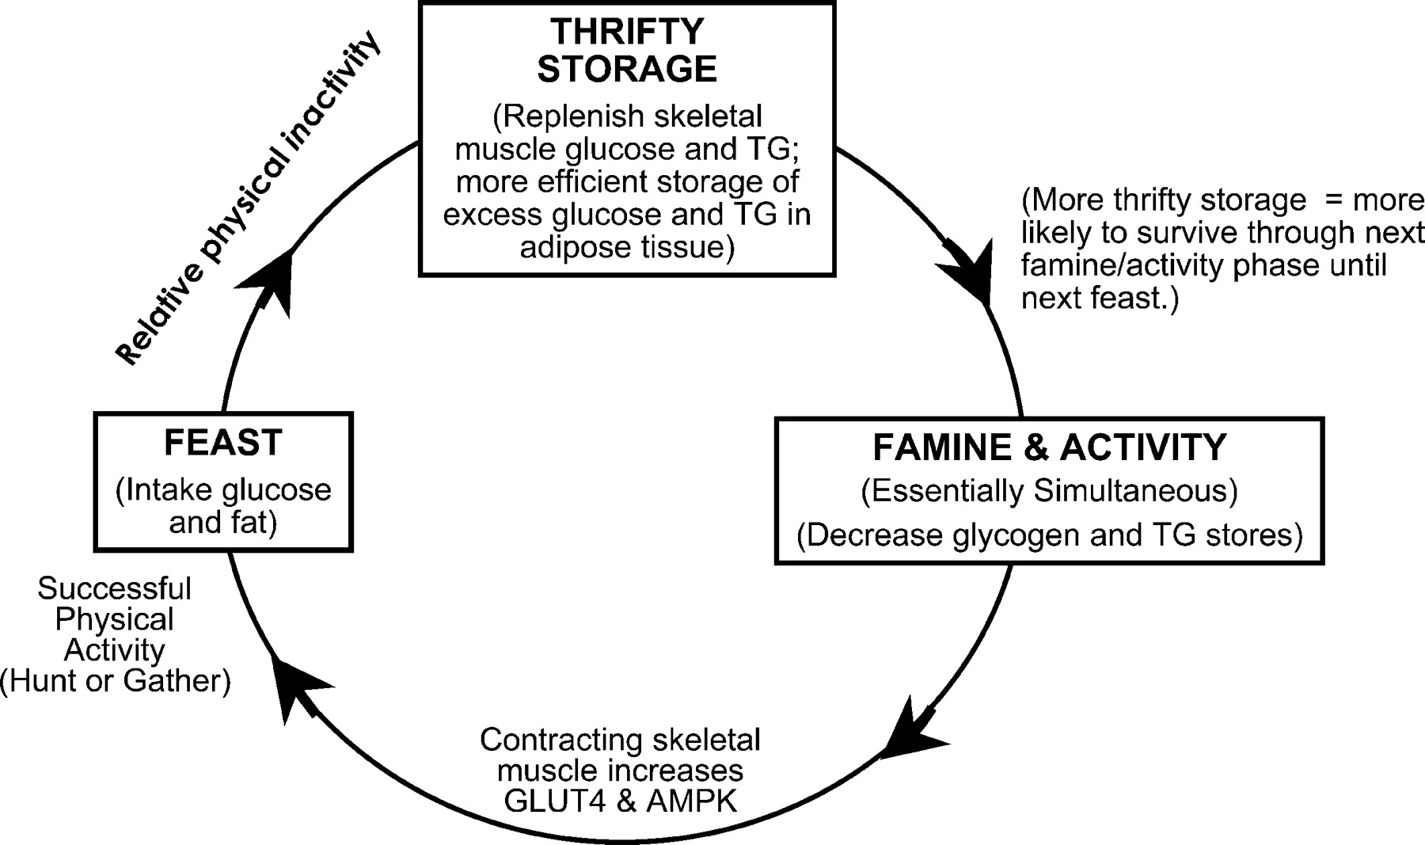
Why the Pima study is important.
The N.I.H. believes that if it can understand why the Pima are so obese it can better understand obesity in the rest of us.
One hypothesis is that through Darwinian natural selection, only Pima who could survive famine and drought were those that were highly adept at storing fat in times of plenty.
In the past these “thrifty genes” were a great advantage, but now, with abundant food, they are a terrible liability.

Slide 18
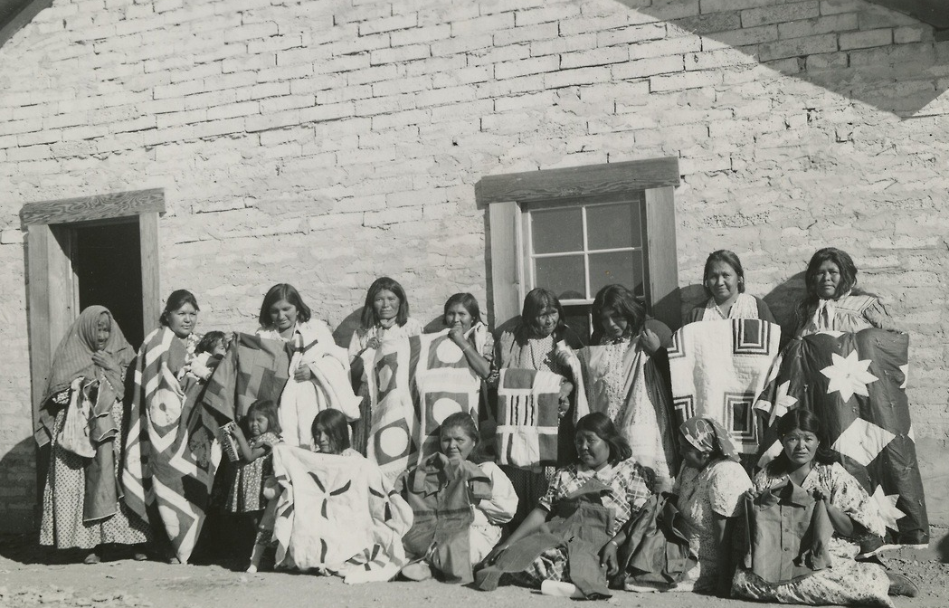
Description of the Pima data set
A population of women who were at least 21 years old, of Pima Indian heritage and living near Phoenix, Arizona, was tested for diabetes according to World Health Organization criteria.
Q 3

Slide 19
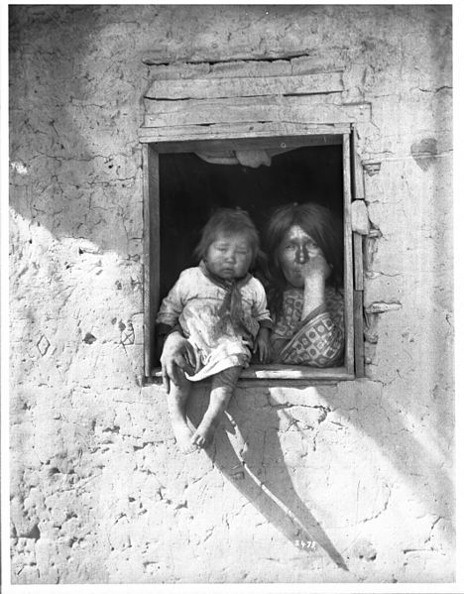
Variables in the Pima data set
npreg number of pregnancies.
glu plasma glucose concentration in an oral glucose tolerance test.
bp diastolic blood pressure (mm Hg).
skin triceps skin fold thickness (mm).
bmi body mass index
ped diabetes pedigree function.
age age in years.
type diabetic according to
WHO criteria.
Q 4

Slide 20
Variables in the Pima data set
npreg number of pregnancies.
glu plasma glucose concentration in an oral glucose tolerance test.
bp diastolic blood pressure (mm Hg).
skin triceps skin fold thickness (mm).
bmi body mass index
ped diabetes pedigree function.
age age in years.
type diabetic according to
WHO criteria.
Q 4

Slide 21
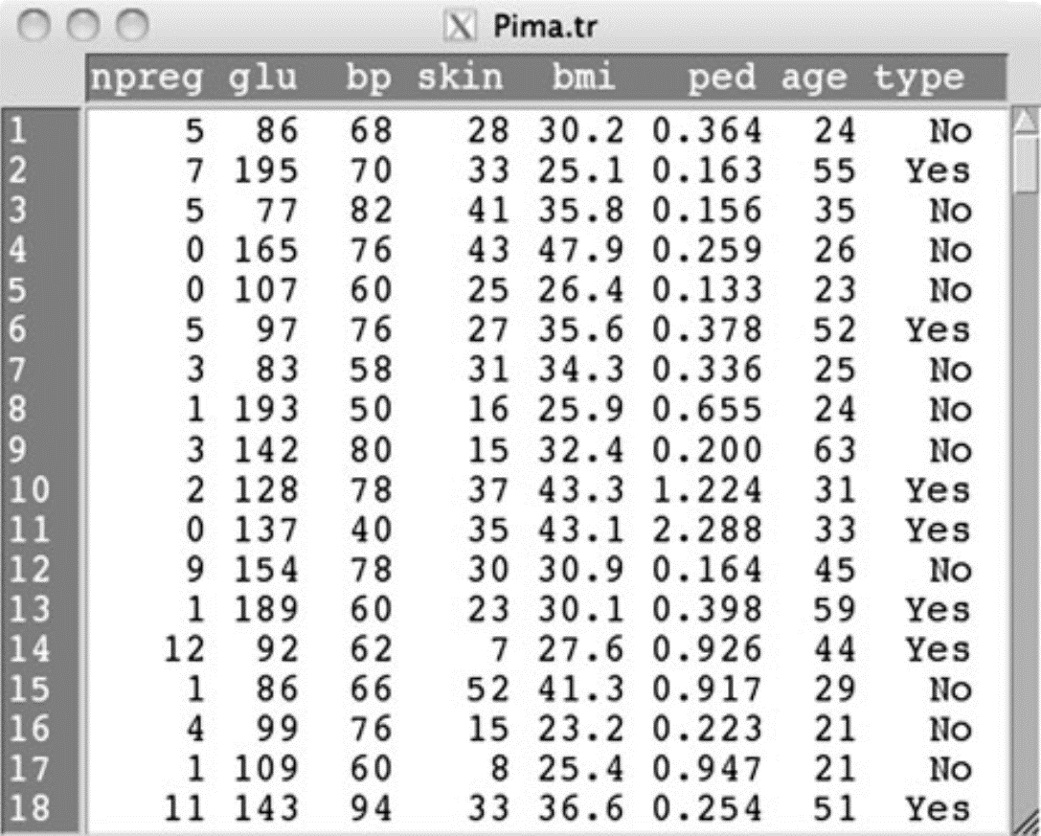

Slide 22
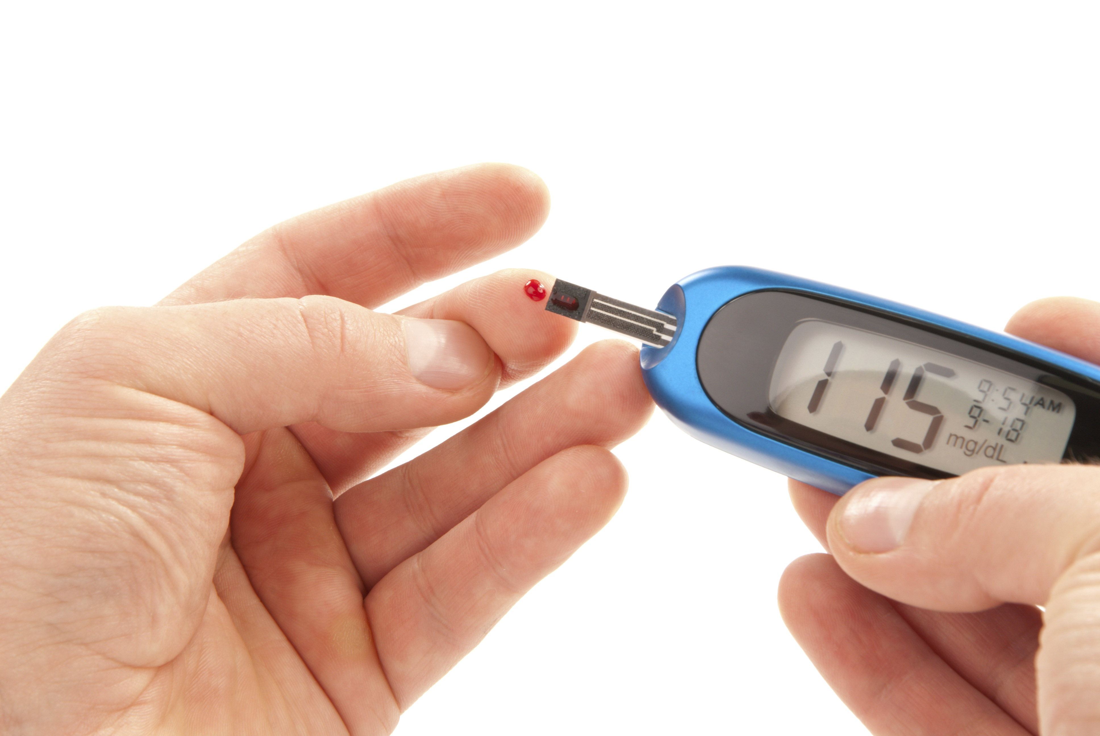
What is the mean plasma glucose concentration?
123.97

Slide 23
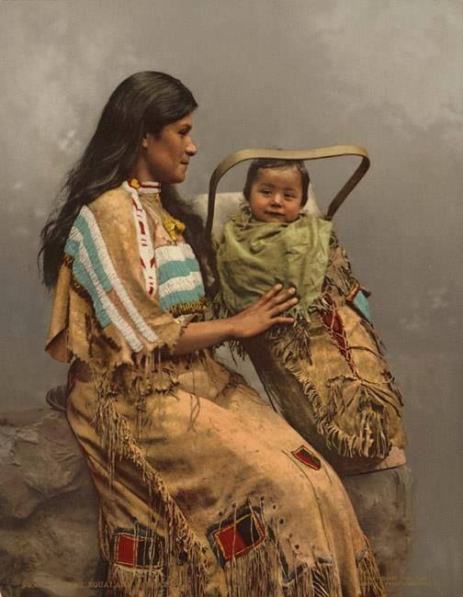
What is the mean number of pregnancies?
[1] 3.57

Slide 24
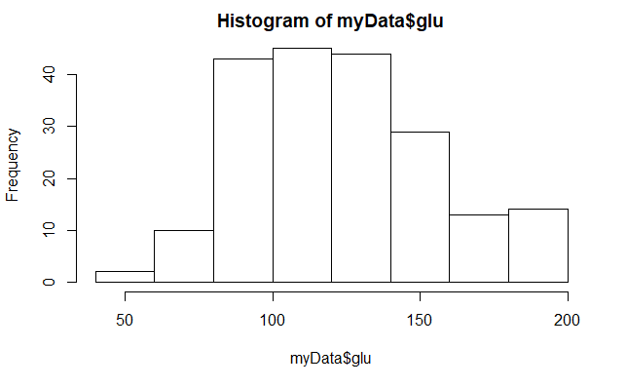

Histogram of plasma glucose concentrations

Slide 25
Data set description
A population of women who were at least 21 years old, of Pima Indian heritage and living near Phoenix, Arizona, was tested for diabetes according to World Health Organization criteria.
Q 3

Slide 26
Variables in the Pima data set
npreg number of pregnancies.
glu plasma glucose concentration in an oral glucose tolerance test.
bp diastolic blood pressure (mm Hg).
skin triceps skin fold thickness (mm).
bmi body mass index
ped diabetes pedigree function.
age age in years.
type diabetic according to
WHO criteria.
Q 4

